Slide 1

COVID-19 IN SPAIN RISK MAP
Avdanina Liubov
Ángel Naranjo Valiente

Slide 2

INDEX
INTRODUCCTION
FLOWCHART
SOURCE OF DATA
DATA
DATA PROCESSING
WHY USE CODING?
OPERATION
RESULTS
CONCLUSION

Slide 3
1. INTRODUCTION
Coronavirus Disease 2019, or COVID-19, poses a threat to global health. While researchers work to develop a vaccine, the rest of the world does their best to prepare for, contain, and help those suffering with the virus.
The objective of the study: To assist these efforts and to controll the spread of the virus, our goal was to create a multivariate risk surface which include risk maps for transmission and death rate of the population of Spain.

Slide 4
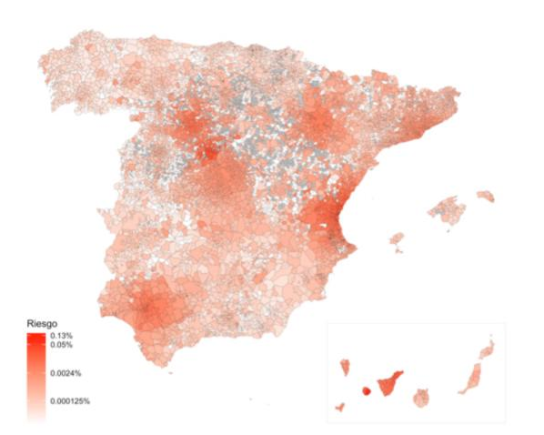
1. INTRODUCCTION II

Slide 5
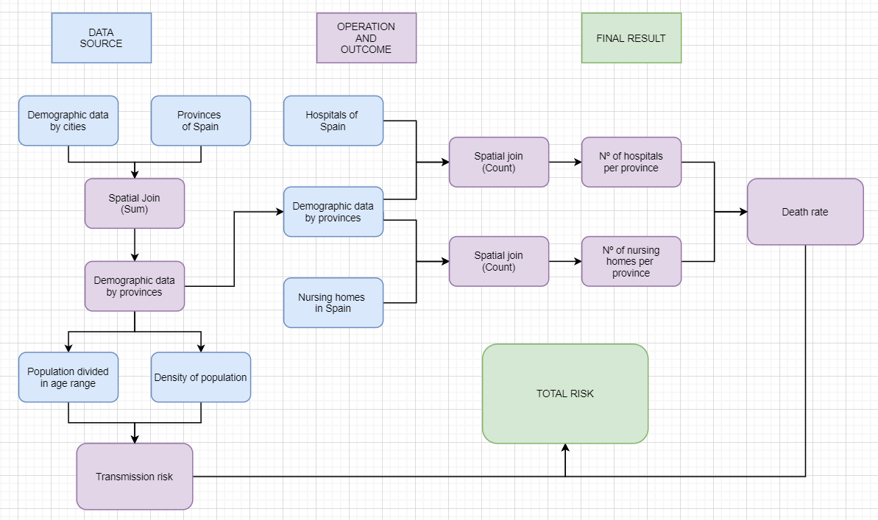
2. FLOWCHART

Slide 6

3. SOURCE OF DATA
Source: Esri Spain
4 layers:
Hospitals of Spain:
https://comunidadsig.maps.arcgis.com/home/item.html?id=68745a7fb7a348b6b0d722c8517790af
Nursing homes:
https://comunidadcovid.maps.arcgis.com/home/item.html?id=e295d0fe5def4102b42bdab776fe67d0
Demographic info by municipalities:
https://comunidadsig.maps.arcgis.com/home/item.html?id=9ca8469ce8db4cd79e3fc4c31cca026e
Provinces of Spain:
https://www.arcgis.com/home/item.html?id=83d81d9336c745fd839465beab885ab7

Slide 7
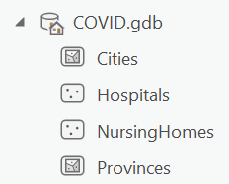
4. DATA
For our project, we used 4 different layers of data:
Demographic info by municipalities (polygons)
Population by age ranges
Density of population
Hospitals of Spain (points)
Nursing homes in Spain
Provinces (polygons)
Shape of each region

Slide 8
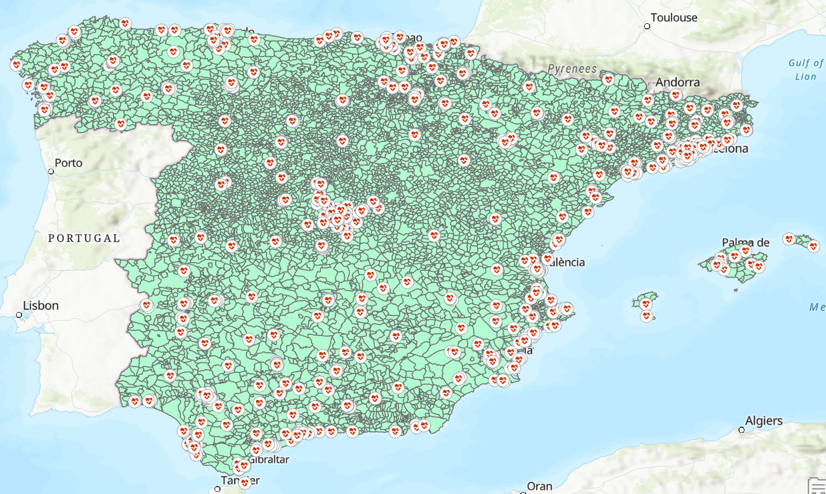
4. DATA II
Cities (population data)
Hospitals (location of hospitals)

Slide 9
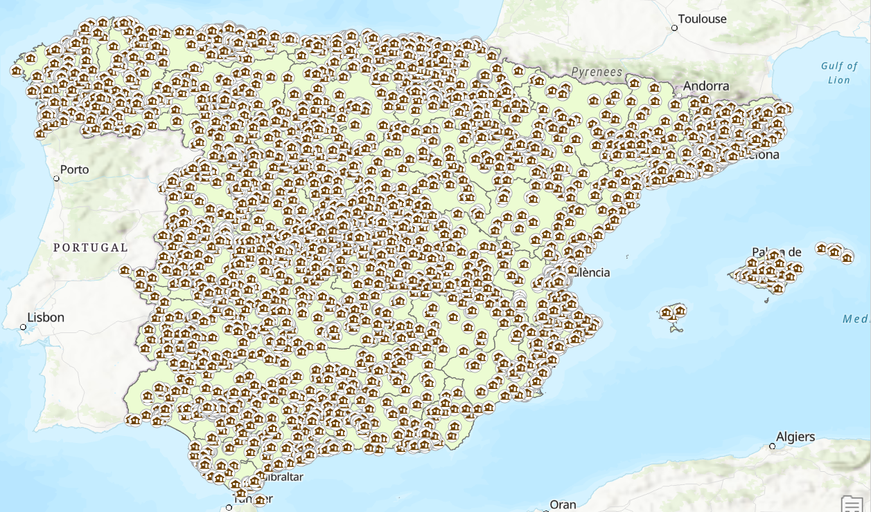
4. DATA III
Province (region shape)
Nursing homes (location of nursing homes)

Slide 10
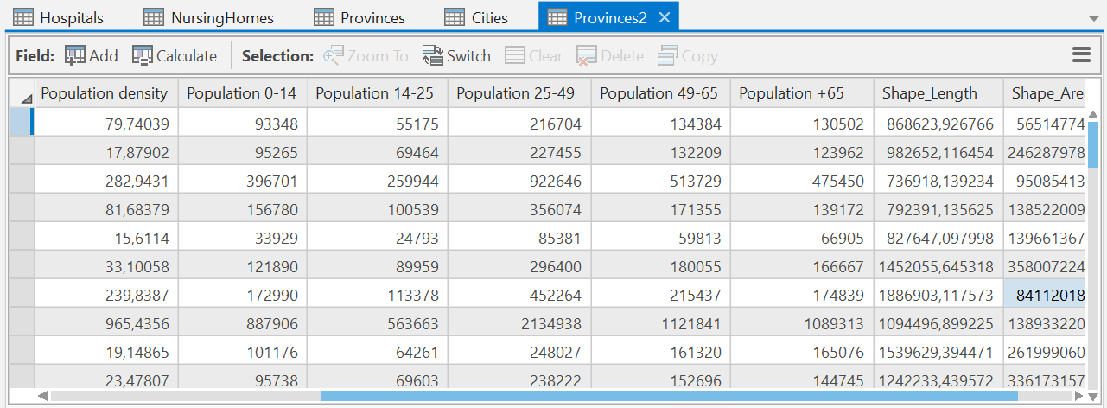
5. DATA PROCESSING
To add these data layers to our project file we did 2 steps in ArcGIS Pro interface:
We export our data to our project using the tool “Feature class to geodatabase” 4 times (once per layer).
We combined “Cities” and “Province” layers into one using the tool “Spatial Join”, creating the new layer “Provinces2”.

Slide 11
6. WHY USE CODING?
To create our risk maps we have used Arcpy instead of the ArcGIS Pro interface.
Why coding is useful in these kind of projects?
It allow you to understand how ArcGIS Pro works.
Having the base file with all the data you can run all the project just typing one word (everyone with the code could do it).
We can implement all the steps in just one function.
You can change how the results will be obtain just changing a few lines. (This allow us to explore different methods of calculation and different results as well).

Slide 12
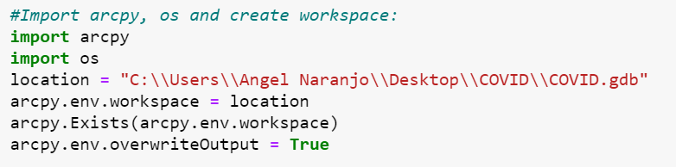
7. OPERATION I
Having our base file with all the data we need to run some tools to obtain our final results:
Count the number of hospitals ands nursing homes in each province
Calculate total population in each region
Calculate transmission risk, death rate and total risk
Normalize the final results in order to have more scaled results
The first step is to import Arcpy and set the workspace:

Slide 13
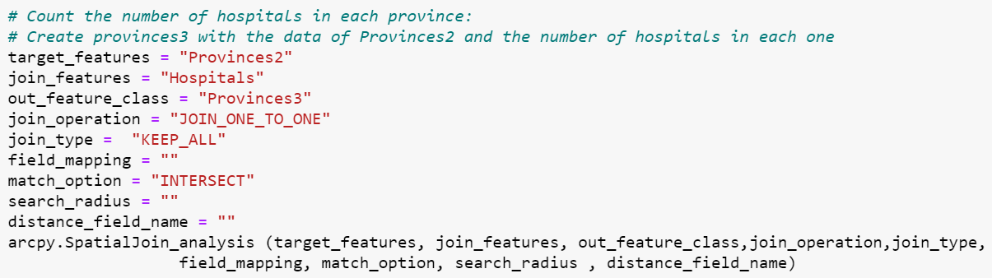
7. OPERATION II
The second step is to calculate the number of hospitals in each province.
Tool: “Spatial Join”
It creates “Provinces3” with the data of “Province2” and the number of hospitals.

Slide 14
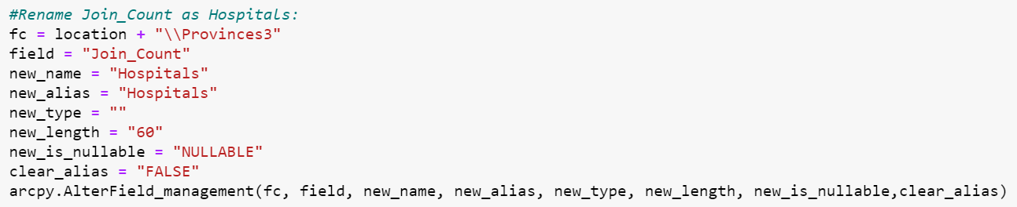
7. OPERATION III
After that, we need to rename the field “Join_Count” as “Hospitals” to avoid errors.
Tool: “AlterField”
Now we can use again the same process to count nursing homes creating “Provinces4”.

Slide 15
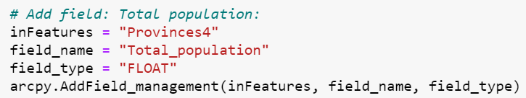
7. OPERATION IV
The next step is to add all the fields that we want to calculate into the layer “Provinces4:
Total population
Transmission risk
Death rate
Total risk
Tool: “Add field”

Slide 16
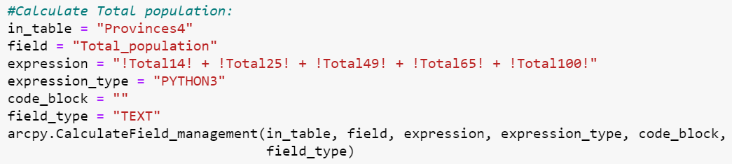
7. OPERATION V
Once we have all the fields in “Provinces4” we can calculate them.
Tool: “Calculate field”

Slide 17
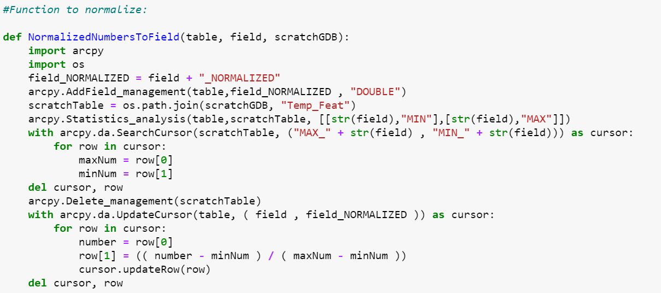
7. OPERATION VI
With all the fields calculated, we need to define a function to normalize all of them in order to have a more scaled map of results.
The function:

Slide 18
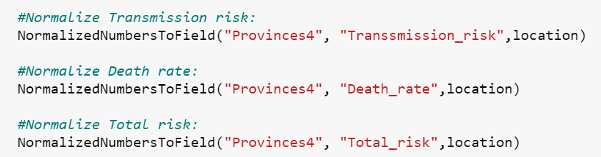
7. OPERATION VII
The last step is to call the function mentioned before to normalize all the results.

Slide 19
7. OPERATION VII
All the steps before has been implemented in a function called “Covid( )” allowing us to run everything just typing it *.
*We also need to change the location line and type where is our project saved:
After running the program, all the results will be on the attribute table of “Provinces4”.
To see them we just need to open our project in ArcGIS Pro and use the tool “Add to current map” to add “Provinces4” to our map (3 times, one per result).

Slide 20
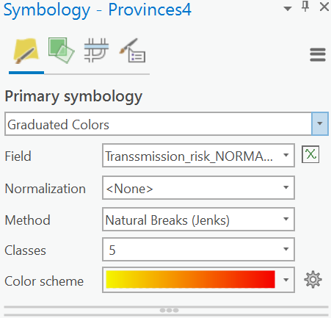
8. RESULTS I
To see property of the results we will need to do right click on “Provinces4”, go to symbology, then graduate colors and finally choose the result we want to see in each case.

Slide 21
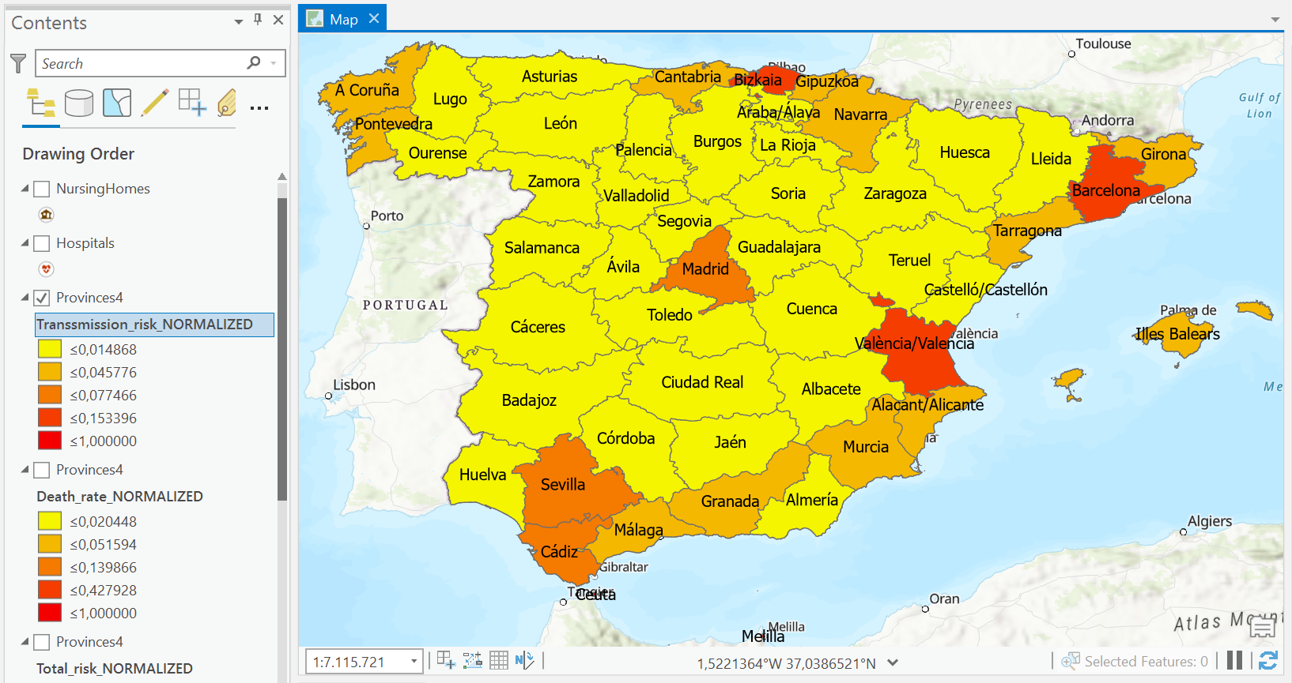
8. RESULTS II (Transmission risk)

Slide 22
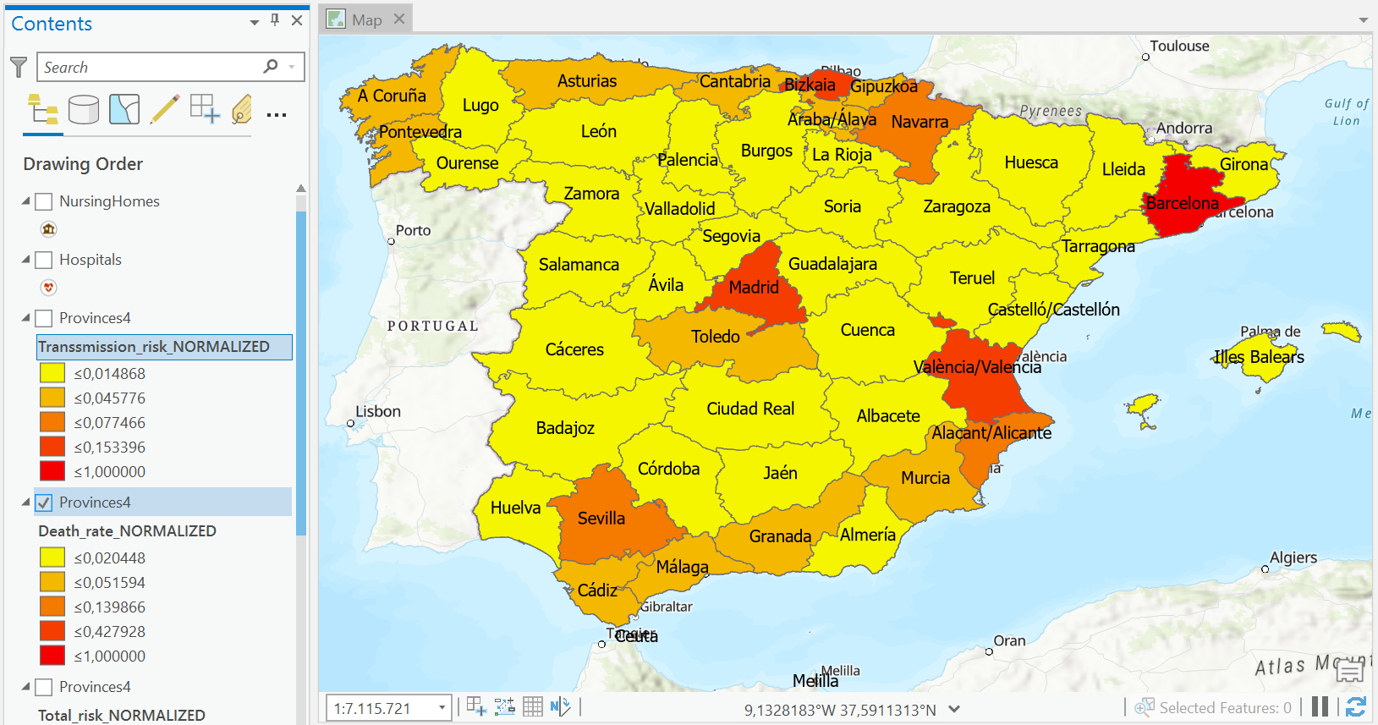
8. RESULTS III (Death rate)

Slide 23
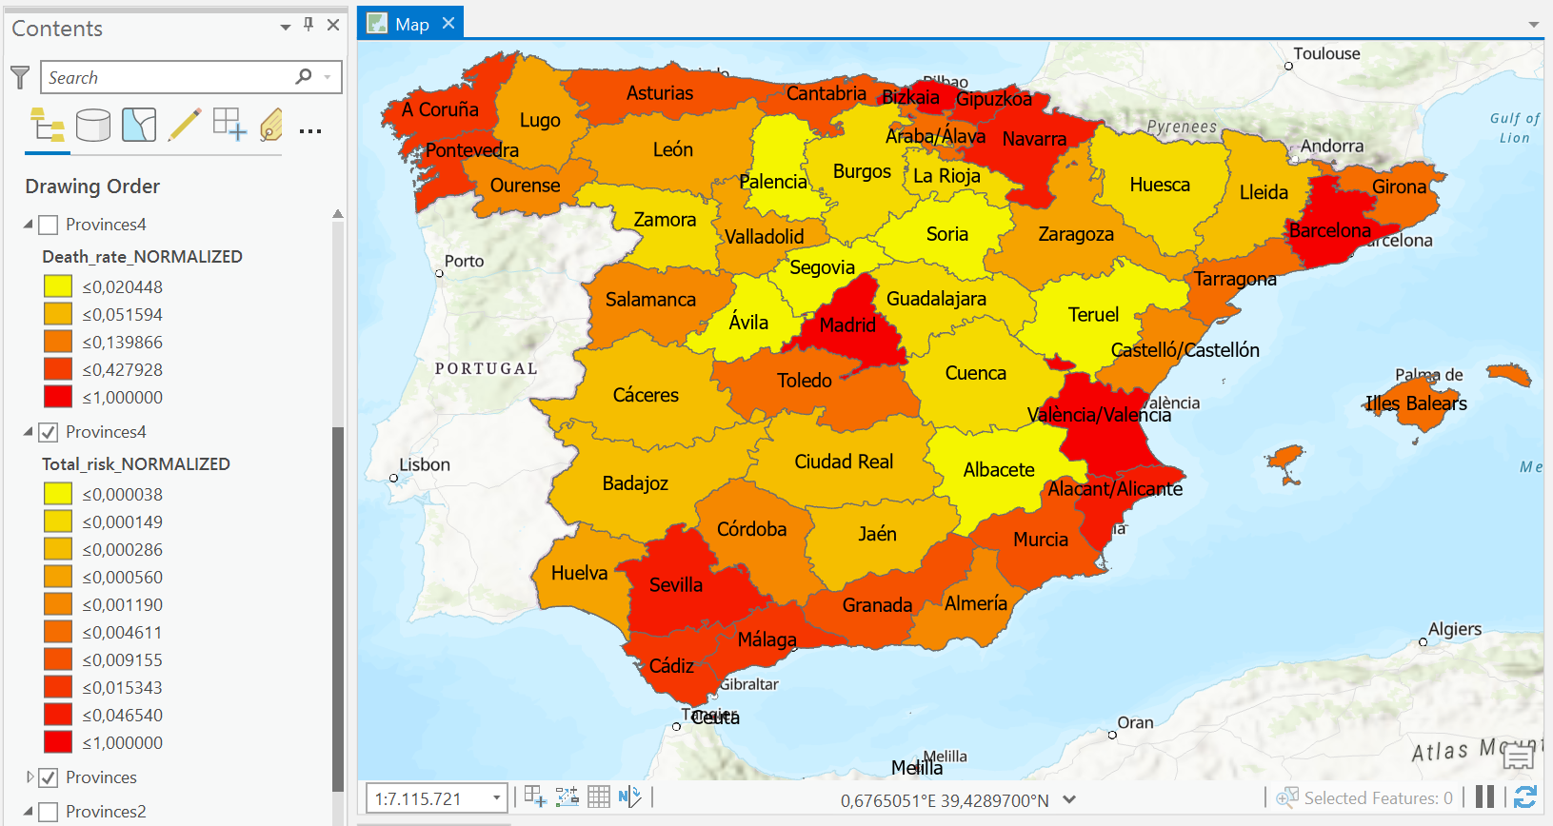
8. RESULTS IV (Total risk)

Slide 24
9. CONCLUSION
With the research done we have found out Spain provinces which pose a great risk of infection and death of the population of this country.
There are: Bizkaia, Valencia, Barcelona, Madrid, Sevilla, Cadiz, Navarra, Alicante and Malaga.
In these provinces the density of population is higher than in the other regions (> 130 per 1 sq km). There are more young and senior population. And that is why it causes to high rate of transmission and death risk.
We would like to offer these provinces to launch additional hospitals to ensure timely treatment of infected people, to strengthen measures to provide social support for elderly people and to limit movement around the province as much as possible.

Slide 25





Thank for your attention
Merci beaucoup

